Slide 1
Greedy Algorithms

Slide 2
Greedy Algorithms
Similar to dynamic programming. Used for optimization problems.
Optimization problems typically go through a sequence of steps, with a set of choices at each step.
For many optimization problems, using dynamic programming to determine the best choices is overkill.
Greedy Algorithm: Simpler, more efficient

Slide 3
Greedy Algorithms
1. the activity-selection problem.
2. basic elements of the GA; knapsack prob.
3. an important application: the design of data compression (Huffman) codes.

Slide 4
First example: Activity Selection
Horseback Riding
Canoeing
Surfing
Driving
Swimming
Rock Climbing
9 | 10 | 11 | 12 | 13 | 14 | 15 | 16 | 17
How to make an arrangement to have the more activities?
S1. Shortest activity first
Swimming , Driving
S2. First starting activity first
Horseback Riding , Driving
S3. First finishing activity first
Swimming , Rock Climbing , Surfing

Slide 5




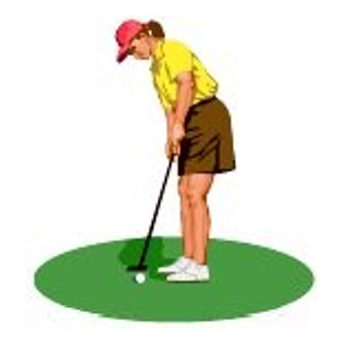
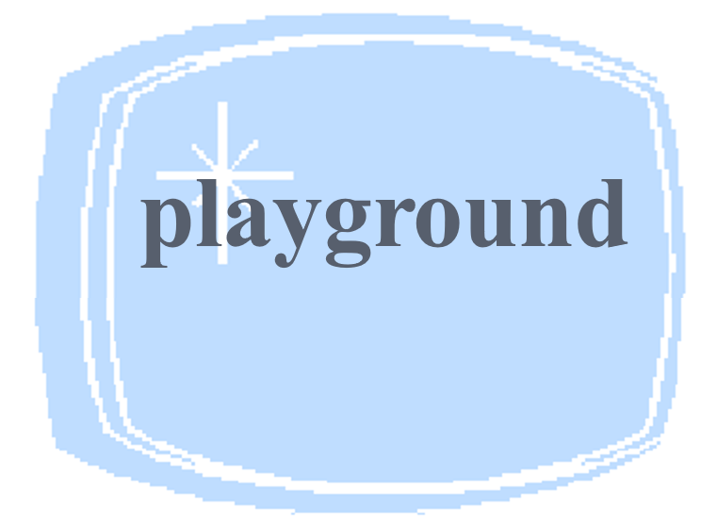
An activity-selection problem
n activities require
exclusive use of a common resource.
Example, scheduling the use of a classroom.
Set of activities S = {a₁, a₂, . . . , a_{n}}.
a_{i} needs resource during period [s_{i} , f_{i} ), which is a half-open interval, where s_{i} is start time and f_{i} is finish time.
Goal: Select the largest possible set of nonoverlapping (mutually compatible) activities.
Other objectives: Maximize income rental fees , …

Slide 6
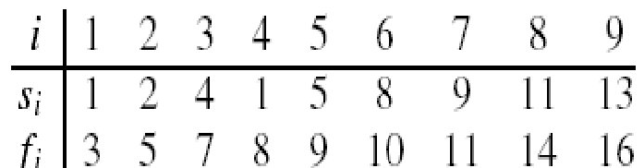

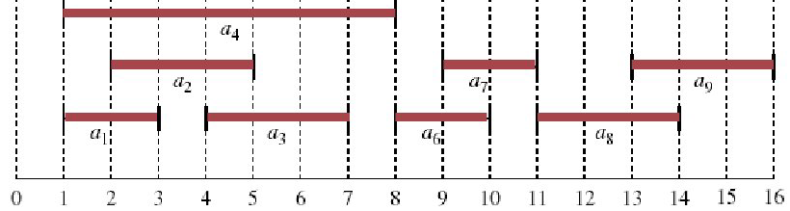
An activity-selection problem
n activities require exclusive use of a common resource.
Set of activities S = {a₁, a₂, . . . , a_{n}}
a_{i} needs resource during period [s_{i} , f_{i} )
Example: S sorted by finish time:
Maximum-size mutually compatible set:
{a₁ , a₃ , a₆ , a₈}.
Not unique: also
{a₂ , a₅ , a₇ , a₉}.

Slide 7
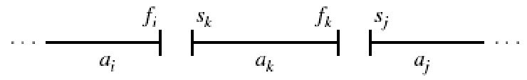
Optimal substructure of activity selection
Space of subproblems
S_{ij} = {a_{k} ∈ S : f_{i} ≤ s_{k} < f_{k} ≤ s_{j} }= activities that start after a_{i} finishes & finish before a_{j} starts
Activities in S_{ij} are compatible with
all activities that finish by f_{i} , and
all activities that start no earlier than s_{j} .
To represent the entire problem, add fictitious activities:
a₀ = [﹣∞, 0); a_{n+1} = [∞, “∞+1”)
We don’t care about ﹣∞ in a₀ or “∞+1” in a_{n+1}.
Then S = S_{0,n+1}. Range for S_{ij} is 0 ≤ i, j ≤ n + 1.

Slide 8
Optimal substructure of activity selection
Space of subproblems
S_{ij} = {a_{k} ∈ S : f_{i} ≤ s_{k} < f_{k} ≤ s_{j} }
Assume that activities are sorted by monotonically increasing finish time
f₀ ≤ f₁ ≤ f₂ ≤ · · · ≤ f_{n} < f_{n+1} (if i ≤ j, then f_{i} ≤ f_{j}) (1)
11
10
9
8
7
6
5
4
3
2
1
0 | 1 | 2 | 3 | 4 | 5 | 6 | 7 | 8 | 9 | 10 | 11 | 12 | 13 | 14

Slide 9
Optimal substructure of activity selection
If f₀ ≤ f₁ ≤ f₂ ≤ · · · ≤ f_{n} < f_{n+1} (if i ≤ j, then f_{i} ≤ f_{j}) (1)
Then i ≥ j ⇒S_{ij} = Ø.
Proof
If there exists a_{k} ∈ S_{ij} , then
f_{i} ≤ s_{k} < f_{k} ≤ s_{j} < f_{j} ⇒ f_{i} < f_{j} .
But i ≥ j ⇒ f_{i} ≥ f_{j} . Contradiction.
So only need to worry about
S_{ij} with 0 ≤i <j≤ n + 1.
All other S_{ij} are Ø.

Slide 10
Optimal substructure of activity selection
Suppose that a solution to S_{ij} includes a_{k} . Have 2 sub-prob
S_{ik} (start after a_{i} finishes, finish before a_{k} starts)
S_{kj} (start after a_{k} finishes, finish before a_{j} starts)
Solution to S_{ij} = (solution to S_{ik} )∪{a_{k}}∪(solution to S_{kj} )
Since a_{k} is in neither of the subproblems, and the subproblems are disjoint, | solution to S_{ij} | = | solution to S_{ik} | + 1 + | solution to S_{kj} | .
Optimal substructure: If an optimal solution to S_{ij} includes a_{k} , then the solutions to S_{ik} and S_{kj} used within this solution must be optimal as well. (use usual cut-and-paste argument).
Let A_{ij} = optimal solution to S_{ij} ,
so A_{ij} = A_{ik}∪{a_{k}}∪A_{kj} , (2)
assuming: S_{ij} is nonempty; and we know a_{k} .

Slide 11
A recursive solution
Let c[i, j ] = size of maximum-size subset of mutually compatible activities in Sij .
i ≥ j ⇒ S_{ij} = Ø ⇒ c[i, j ] = 0.
If S_{ij} ≠ Ø, suppose that a_{k} is used in a maximum-size subsets of mutually S_{ij} . Then c[i, j] = c[i, k] + 1 + c[k, j ] .
But of course we don’t know which k to use, and so
Why this range of k? Because S_{ij} = {a_{k}∈S: f_{i} ≤ s_{k} < f_{k} ≤ s_{j} }⇒a_{k} can’t be a_{i} or a_{j} .
0 , if S_{ij} = Ø (3)
c[i, j] =
max{c[i, k ] + c[k , j ] + 1} , if S_{ij} ≠ Ø
i <k<j
a_{k} ∈ S_{ij}

Slide 12
Converting a DP solution to a greedy solution
0 , if S_{ij} = Ø (3)
c[i, j] =
max{c[i, k ] + c[k , j ] + 1} , if S_{ij} ≠ Ø
i <k<j
a_{k} ∈ S_{ij}
It may be easy to design an algorithm to the problem based on recurrence (16.3).
Direct recursion algorithm (complexity?)
Dynamic programming algorithm (complexity?)
Can we simplify our solution?

Slide 13
Converting a DP solution to a greedy solution
Theorem 1
Let S_{ij} ≠ Ø , and let a_{m} be the activity in S_{ij} with the earliest finish time: f_{m} = min {f_{k} : a_{k} ∈ S_{ij} }. Then
a_{m} is used in some maximum-size subset of mutually compatible activities of S_{ij} .
S_{im} = Ø , so that choosing a_{m} leaves S_{mj} as the only nonempty subproblem.
11
10
9
8
7
6
5
4
3
2
1
0 | 1 | 2 | 3 | 4 | 5 | 6 | 7 | 8 | 9 | 10 | 11 | 12 | 13 | 14

Slide 14
Converting a DP solution to a greedy solution
Theorem 1
Let S_{ij} ≠ Ø , and let a_{m} be the activity in S_{ij} with the earliest finish time: f_{m} = min {f_{k} : a_{k} ∈ S_{ij} }. Then
a_{m} is used in some maximum-size subset of mutually compatible activities of S_{ij} .
S_{im} = Ø , so that choosing a_{m} leaves S_{mj} as the only nonempty subproblem.
Proof
Suppose there is some a_{l} ∈ S. Then f_{i} < s_{l} < f_{l} ≤ s_{m} < f_{m} ⇒ f_{l} < f_{m} Then a_{l} ∈ S_{ij} and it has an earlier finish time than f_{m} , which contradicts our choice of a_{m} . Therefore, there is no a_{l} ∈ S_{im}⇒ S_{im} = Ø.

Slide 15
Converting a DP solution to a greedy solution
Theorem 1
Let S_{ij} ≠ Ø , and let a_{m} be the activity in S_{ij} with the earliest finish time: f_{m} = min {f_{k} : a_{k} ∈ S_{ij} }. Then
a_{m} is used in some maximum-size subset of mutually compatible activities of S_{ij} .
Proof
Let A_{ij} be a maximum-size subset of mutually Compatible activities in S_{ij} . Order activities in A_{ij} in monotonically increasing order of finish time. Let a_{k} be the first activity in A_{ij} .
If a_{k} = a_{m} , done (a_{m} is used in a maximum-size subset).
Otherwise, construct B_{ij}=A_{ij} -{a_{k}}∪{a_{m}} (replace a_{k} by a_{m}). Activities in B_{ij} are disjoint. (Activities in A_{ij} are disjoint, a_{k} is the first activity in A_{ij} to finish. f_{m}≤f_{k} ⇒ a_{m} doesn’t overlap anything else in B_{ij} ). Since |B_{ij} | = |A_{ij} | and A_{ij} is a maximum-size subset, so is B_{ij} .

Slide 16
Converting a DP solution to a greedy solution
0 , if S_{ij} = Ø (3)
c[i, j] =
max{c[i, k ] + c[k , j ] + 1} , if S_{ij} ≠ Ø
i <k<j
a_{k} ∈ S_{ij}
Theorem 16.1
Let S_{ij} ≠ Ø , and let a_{m} be the activity in S_{ij} with the earliest finish time: f_{m} = min {f_{k} : a_{k} ∈ S_{ij} }. Then
a_{m} is used in some maximum-size subset of mutually compatible activities of S_{ij} .
S_{im} = Ø , so that choosing a_{m} leaves S_{mj} as the only nonempty subproblem.
This theorem is great:
 | before theorem | after theorem
# of sub-prob in optimal solution | 2 | 1
# of choices to consider | O(j – i -1) | 1

Slide 17
Converting a DP solution to a greedy solution
Theorem 1
Let S_{ij} ≠ Ø , and let a_{m} be the activity in S_{ij} with the earliest finish time: f_{m} = min {f_{k} : a_{k} ∈ S_{ij} }. Then
a_{m} is used in some maximum-size subset of mutually compatible activities of S_{ij} .
S_{im} = Ø , so that choosing a_{m} leaves S_{mj} as the only nonempty subproblem.
Now we can solve a problem S_{ij} in a top-down fashion
Choose a_{m} ∈ S_{ij} with earliest finish time: the greedy choice. ( it leaves as much opportunity as possible for the remaining activities to be scheduled )
Then solve S_{mj} .

Slide 18
Converting a DP solution to a greedy solution
What are the subproblems?
Original problem is S_{0,n+1} 〔 a₀ = [﹣∞, 0); a_{n+1} = [∞, “∞+1”) 〕
Suppose our first choice is a_{m1} (in fact, it is a₁)
Then next subproblem is S_{m1,n+1}
Suppose next choice is a_{m2} (it must be a₂?) Next subproblem is S_{m2,n+1}
And so on
11
10
9
8
7
6
5
4
3
2
1
0 | 1 | 2 | 3 | 4 | 5 | 6 | 7 | 8 | 9 | 10 | 11 | 12 | 13 | 14

Slide 19
Converting a DP solution to a greedy solution
What are the subproblems?
Original problem is S_{0,n+1} 〔 a₀ = [﹣∞, 0); a_{n+1} = [∞, “∞+1”) 〕
Suppose our first choice is a_{m1} (in fact, it is a₁)
Then next subproblem is S_{m1,n+1}
Suppose next choice is a_{m2} (it must be a₂?) Next subproblem is S_{m2,n+1}
And so on
Each subproblem is S_{mi ,n+1}.
And the subproblems chosen have finish times that increase.
Therefore, we can consider each activity just once, in monotonically increasing order of finish time.

Slide 20
A recursive greedy algorithm
Original problem is S_{0,n+1}
Each subproblem is S_{mi ,n+1}
Assumes activites already sorted by monotonically increasing finish time. (If not, then sort in O(n lg n) time.) Return an optimal solution for S_{i,n+1}:
×
a_{m}
√
a_{m}
a_{i}
a_{i}
REC-ACTIVITY-SELECTOR(s, f, i, n)
1 m ← i+1
while m≤n and sm< fi // Find first activity in Si,n+1.
do m ← m+1
if m≤ n
then return {am}∪REC-ACTIVITY-SELECTOR(s, f, m, n)
else return Ø

Slide 21
A recursive greedy algorithm
REC-ACTIVITY-SELECTOR(s, f, i, n)
1 m ← i+1
while m≤n and sm< fi // Find first activity in Si,n+1.
do m ← m+1
if m≤ n
then return {am}∪REC-ACTIVITY-SELECTOR(s, f, m, n)
else return Ø
√
a_{m}
Initial call: REC-ACTIVITY-SELECTOR(s, f, 0, n).
Idea: The while loop checks a_{i+1} , a_{i+2} , . . . , a_{n} until
it finds an activity a_{m} that is compatible with a_{i} (need s_{m}≥ f_{i} ).
If the loop terminates because a_{m} is found (m≤n), then recursively solve S_{m,n+1}, and return this solution, along with a_{m}.
If the loop never finds a compatible a_{m} (m > n), then just return empty set.
a_{i}

Slide 22
A recursive greedy algorithm
REC-ACTIVITY-SELECTOR(s, f, i, n)
1 m ← i+1
while m≤n and sm< fi // Find first activity in Si,n+1.
do m ← m+1
if m≤ n
then return {am}∪REC-ACTIVITY-SELECTOR(s, f, m, n)
else return Ø
Time: Θ(n)—each activity examined exactly once.
T (n) =m1 + T (n－ m1 ) =m1 + m2 + T (n － m1 －m2 )
= m1 + m2 + m3 + T (n － m1 － m2 － m3 ) = …
= Σ mk + T (n － Σmk )
because: n－Σmk = 1, then Σmk = n −1, Σm_{k} + T (1) = Θ(n)

Slide 23
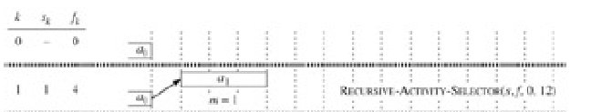
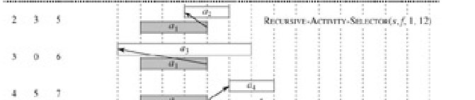
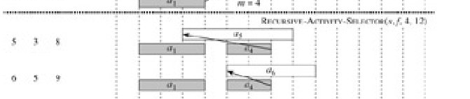
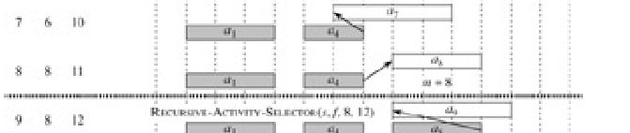
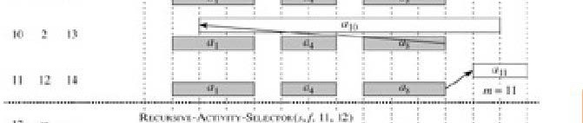
A recursive greedy algorithm
Initial call: REC-ACTIVITY-SELECTOR(s, f, 0, n).
Idea: The while loop checks a_{i+1} , a_{i+2} , . . . , a_{n} until it finds an activity a_{m} that is compatible with a_{i} (need s_{m}≥ f_{i} ).
If the loop terminates because a_{m} is found (m≤n), then recursively solve S_{m,n+1}, and return this solution, along with a_{m}.
If the loop never finds a compatible a_{m} (m > n), then just return empty set.

Slide 24
An iterative greedy algorithm
REC-ACTIVITY-SELECTOR is almost “tail recursive”.
We easily can convert the recursive procedure to an iterative one. (Some compilers perform this task automatically)
GREEDY-ACTIVITY-SELECTOR(s, f, n)
1 A ← {a1}
2 i ← 1
3 for m ← 2 to n
4 do if sm ≥ fi
5 then A←A∪{am}
6 i← m // ai is most recent addition to A
7 return A
×
a_{m}
√
a_{m}
a_{i}
a_{i}

Slide 25
Review
Greedy Algorithm Idea: When we have a choice to make, make the one that looks best right now. Make a locally optimal choice in hope of getting a globally optimal solution.
Greedy Algorithm: Simpler, more efficient

Slide 26
Greedy Algorithms
1. the activity-selection problem.
2. basic elements of the GA; knapsack prob.
3. an important application: the design of data compression (Huffman) codes.

Slide 27
Elements of the greedy strategy
The choice that seems best at the moment is chosen.
What did we do for activity selection?
Determine the optimal substructure.
Develop a recursive solution.
Prove that at any stage of recursion, one of the optimal choices is the greedy choice.
Show that all but one of the subproblems resulting from the greedy choice are empty.
Develop a recursive greedy algorithm.
Convert it to an iterative algorithm.

Slide 28
Elements of the greedy strategy
These steps looked like dynamic programming.
Typically, we streamline these steps
Develop the substructure with an eye toward
making the greedy choice,
leaving just one subproblem.
For activity selection, we showed that the greedy choice implied that in S_{ij} , only i varied, and j was fixed at n+1,
So, we could have started out with a greedy algorithm in mind:
define S_{i} = {a_{k} ∈ S : f_{i} ≤ s_{k} },
show the greedy choice, first a_{m} to finish in S_{i}
combined with optimal solution to S_{m}
⇒ optimal solution to S_{i} .

Slide 29
Elements of the greedy strategy
Typical streamlined steps
Cast the optimization problem as one in which we make a choice and are left with one subproblem to solve.
Prove that there’s always an optimal solution that makes the greedy choice, so that the greedy choice is always safe.
Show that greedy choice and optimal solution to subproblem ⇒ optimal solution to the problem.

Slide 30
Elements of the greedy strategy
No general way to tell if a greedy algorithm is optimal, but two key ingredients are
greedy-choice property
optimal substructure

Slide 31
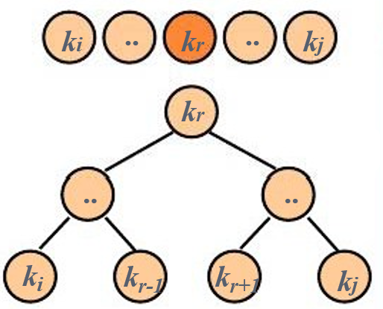
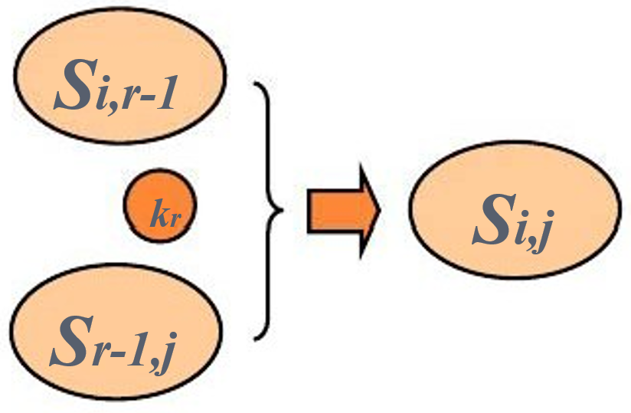
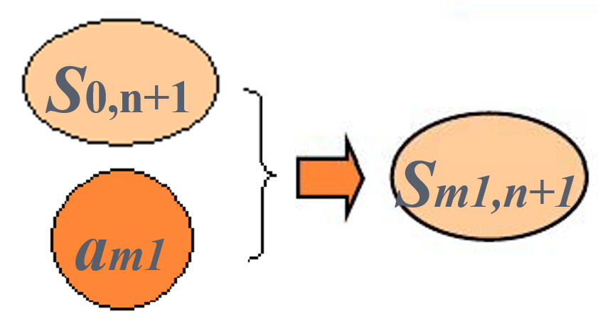
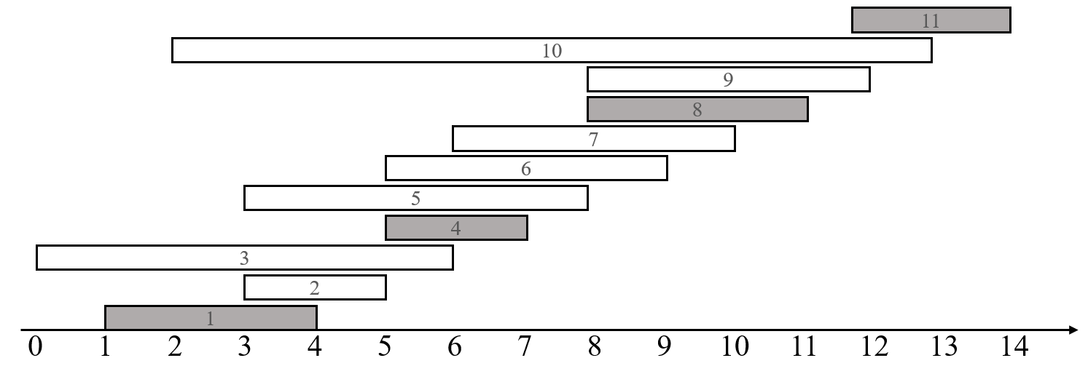
Greedy-choice property
A globally optimal solution can be arrived at by making a locally optimal (greedy) choice.
Dynamic programming
Make a choice at each step.
Choice depends on knowing optimal solutions to subproblems. Solve subproblems first.
Solve bottom-up.
Greedy
Make a choice at each step.
Make the choice before solving the subproblems.
Solve top-down.

Slide 32
Greedy-choice property
We must prove that a greedy choice at each step yields a globally optimal solution. Difficulty! Cleverness may be required!
Typically, Theorem 16.1, shows that the solution (A_{ij}) can be modified to use the greedy choice (a_{m}), resulting in one similar but smaller subproblem (A_{mj}).
We can get efficiency gains from greedy-choice property. (For example, in activity-selection, sorted the activities in monotonically increasing order of finish times, needed to examine each activity just once.)
Preprocess input to put it into greedy order

Slide 33
Optimal substructure
optimal substructure: an optimal solution to the problem contains within it optimal solutions to subproblems.
Just show that optimal solution to subproblem and greedy choice ⇒ optimal solution to problem.

Slide 34

Greedy vs. dynamic programming
50
50
$$\frac{\text{20}}{\text{30}}$$
50
30
50
50
$80
item 3
$100
30
+
item 2
30
20
$120
20
+
$100
$100
20
20
item 1
$120
+
+
+
10
10
$60
10
$60
10
$60
$60
$100
$120
knapsack
=$220
=$180
=$180
=$240
knapsack problem
0-1knapsack problem
Fractional
knapsack problem
0-1 knapsack problem
n items
Item i is worth $v_{i} , weighs w_{i} pounds
Find a most valuable subset of items with total weight ≤W.
Have to either take an item or not take it can’t take part of it.
Fractional knapsack problem
Like the 0-1 knapsack problem, but can take fraction of an item.

Slide 35
Greedy vs. dynamic programming
0-1 knapsack problem
Fractional knapsack problem
Both have optimal substructure property.
0-1 : choose the most valuable load j that weighs w_{j} ≤ W, remove j , choose the most valuable load i that weighs w_{i} ≤W-w_{j}
fractional: choose a weight w from item j ( part of j ), then remove the part, the remaining load is the most valuable load weighing at most W-w that the thief can take from the n-1 original items plus w_{j}-w pounds from item j.
But the fractional problem has the greedy-choice property, and the 0-1 problem does not.

Slide 36
Greedy vs. dynamic programming
50
50
$$\frac{\text{20}}{\text{30}}$$
50
30
50
50
$80
item 3
$100
30
+
item 2
30
20
$120
20
+
$100
$100
20
20
item 1
$120
+
+
+
10
10
$60
10
$60
10
$60
$60
$100
$120
knapsack
=$220
=$180
=$180
=$240
Fractional knapsack problem has the greedy-choice property, and the 0-1 knapsack problem does not.
To solve the fractional problem, rank decreasingly items by v_{i} /w_{i}
Let v_{i} /w_{i} ≥ v_{i+1} /w_{i+1}
for all i
Time: O(nlg n) to sort, O(n) to greedy choice thereafter.
FRACTIONAL-KNAPSACK(v,w,W)
1 load ← 0
2 i ← 1
3 while load < W and i ≤ n
do if wi ≤ W - load
then take all of item i
else take W-load of wi from item i
add what was taken to load
8 i ←i + 1

Slide 37
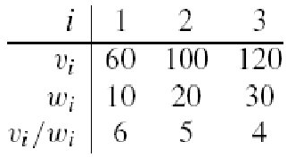

Greedy vs. dynamic programming
0-1 knapsack problem has not the greedy-choice property
W = 50.
Greedy solution:
take items 1 and 2
value = 160, weight = 30
20 pounds of capacity leftover.
Optimal solution:
Take items 2 and 3
value=220, weight=50
No leftover capacity.
50
50
$$\frac{\text{20}}{\text{30}}$$
50
30
50
50
$80
item 3
$100
30
+
item 2
30
20
$120
20
+
$100
$100
20
20
item 1
$120
+
+
+
10
10
$60
10
$60
10
$60
$60
$100
$120
knapsack
=$220
=$180
=$180
=$240
knapsack problem
0-1knapsack problem
Fractional
knapsack problem

Slide 38
Greedy Algorithms
1. the activity-selection problem.
2. basic elements of the GA; knapsack prob.
3. an important application: the design of data compression (Huffman) codes.

Slide 39
Huffman codes
Huffman codes: widely used and very effective technique for compressing data.
savings of 20% to 90%
Consider the data to be a sequence of characters
Abaaaabbbdcffeaaeaeec
Huffman's greedy algorithm:
uses a table of the frequencies of occurrence of the characters to build up an optimal way of representing each character as a binary string.

Slide 40
Huffman codes
Wish to store compactly 100,000-character data file
only six different characters appear. frequency table
Many ways (encodes) to represent such a file of information
binary character code (or code for short): each character is represented by a unique binary string.
fixed-length code: if use 3-bit codeword, the file can be encoded in 300,000 bits. Can we do better?
 | a | b | c | d | e | f
Frequency (in thousands) | 45 | 13 | 12 | 16 | 9 | 5
Fixed-length codeword | 000 | 001 | 010 | 011 | 100 | 101
Variable-length codeword | 0 | 101 | 100 | 111 | 1101 | 1100

Slide 41
Huffman codes
100,000-character data file
binary character code (or code for short)
variable-length code: by giving frequent characters short codewords and infrequent characters long codewords, here the 1-bit string 0 represents a, and the 4-bit string 1100 represents f.
(45·1 + 13·3 + 12·3 + 16·3 + 9·4 + 5·4) · 1,000 = 224,000 bits
 | a | b | c | d | e | f
Frequency (in thousands) | 45 | 13 | 12 | 16 | 9 | 5
Fixed-length codeword | 000 | 001 | 010 | 011 | 100 | 101
Variable-length codeword | 0 | 101 | 100 | 111 | 1101 | 1100

Slide 42
Huffman codes
100,000-character data file
binary character code (or code for short)
fixed-length code: 300,000 bits
variable-length code: 224,000 bits, a savings of approximately 25%. In fact, this is an optimal character code for this file.
 | a | b | c | d | e | f
Frequency (in thousands) | 45 | 13 | 12 | 16 | 9 | 5
Fixed-length codeword | 000 | 001 | 010 | 011 | 100 | 101
Variable-length codeword | 0 | 101 | 100 | 111 | 1101 | 1100

Slide 43
Prefix codes
prefix codes (prefix-free codes): no codeword is a prefix of some other codeword.
Encoding is always simple for any binary character code
Concatenate the codewords representing each character. For example, “abc”, with the variable-length prefix code as 0·101·100 = 0101100, where we use ‘·’ to denote concatenation.
Prefix codes simplify decoding.
 | a | b | c | d | e | f
Frequency (in thousands) | 45 | 13 | 12 | 16 | 9 | 5
Fixed-length codeword | 000 | 001 | 010 | 011 | 100 | 101
Variable-length codeword | 0 | 101 | 100 | 111 | 1101 | 1100

Slide 44
Prefix codes
prefix codes (prefix-free codes): no codeword is a prefix of some other codeword.
Encoding is always simple for any binary character code
Prefix codes simplify decoding
Since no codeword is a prefix of any other, the codeword that begins an encoded file is unambiguous.
We can simply identify the initial codeword, translate it back to the original character, and repeat the decoding process on the remainder of the encoded file.
Exam: 001011101 uniquely as 0·0·101·1101, which decodes to “aabe”.
 | a | b | c | d | e | f
Variable-length codeword | 0 | 101 | 100 | 111 | 1101 | 1100

Slide 45
Huffman codes
Path: Mark the left side 0 and the right side 1.
Coding tree
100
0
1
a: 45
55
1
0
Internal node: labeled by the frequency and the leaf of its subtree.
25
30
0
1
0
1
c: 12
b: 13
14
d: 16
0
1
Leaf node: labeled with a character and its frequency of occurrence.
f: 5
e: 9

Slide 46
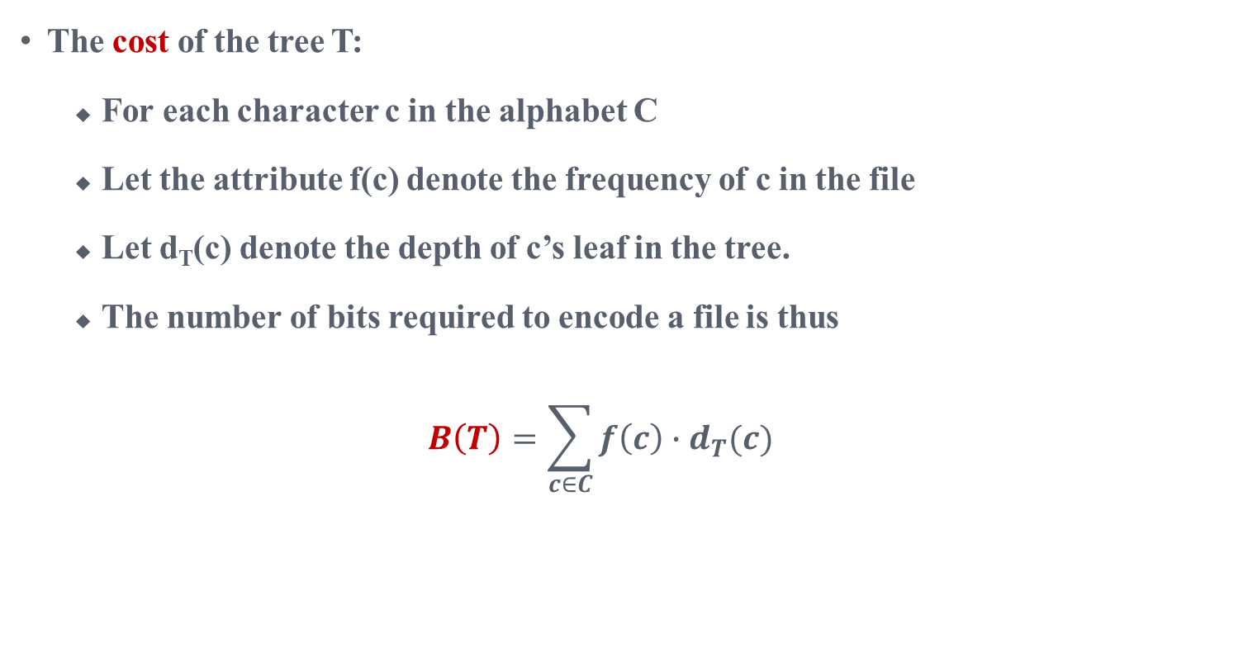
Huffman codes
The cost of the tree T:
For each character c in the alphabet C
Let the attribute f(c) denote the frequency of c in the file
Let d_{T}(c) denote the depth of c’s leaf in the tree.
The number of bits required to encode a file is thus
$$B\left(T\right)=\sum_{c∈C}{f\left(c\right)∙d_{T}(c)}$$

Slide 47
Huffman codes
How to build a optimal coding tree?
Input: alphabet C = {c₁, c₂, ...., c_{n} },
frequency table F = {f(c₁), f(c₂), ..., f(c_{n})}
Output: a code tree with minimal B(T)
Greedy algorithm：
The two nodes with the lowest frequency are iteratively selected to generate a subtree until a tree is formed

Slide 48
Correctness of Huffman’s algorithm
Correctness of Huffman’s algorithm
To prove that the greedy algorithm HUFFMAN is correct, we need to prove
The optimization prefix tree problem has an optimization substructure
The problem of optimizing prefix tree has greedy selectivity

Slide 49
Optimal-substructure
Lemma 1
Let T be an optimized prefix tree of the alphabet C, ∀c∈C， f(c) is the frequency of occurrence of c in the file. Let x and y be any two adjacent leaf nodes in T, and z be their parent node, then z is a character with its frequency f (z) = f (x) + f (y) , and T’=T-{x,y} is the optimized prefix encoding tree of alphabet of C’=C-{x,y}∪{z}
T
0
1
T’
0
1
b
f(b)
0
1
f(b)
0
1
b
f(c)
z
c
0
1
f(c)
c
z
f(x)+f(y)
f(x)
x
y
f(y)

Slide 50
Proof of Lemma 1
Proof B(T)=B(T’)+f(x)+f(y).
∀v∈C-{x,y}, d_{T}(v)=d_{T’}(v), f(v)d_{T}(v)=f(v)d_{T’}(v).
because d_{T}(x)=d_{T}(y)=d_{T’}(z)+1,
f(x)d_{T}(x)+f(y)d_{T}(y)
=(f(x)+f(y))(d_{T’}(z)+1)
=(f(x)+f(y))d_{T’}(z)+(f(x)+f(y))
Because f(x)+f(y)=f(z), f(x)d_{T}(x)+f(y)d_{T}(y)=f(z)d_{T’}(z)+(f(x)+f(y)).
so B(T)=B(T’)+f(x)+f(y).
We now prove the lemma by contradiction. Suppose that T’ does not represent an optimal prefix code for C’. Then there exists another optimal tree T’’ such that B(T’’) < B(T’). Because z is character of C’, so it is a leaf of tree T’’. Adding nodes x and y to T’’, as child nodes of z, then we get a prefix coding tree of C,T’’’:
T’
T’’
0
1
0
1
b
f(b)
u
f(u)
0
1
0
1
f(c)
c
z
f(x)+f(y)
v
f(v)
z
f(z)

Slide 51
Proof of Lemma 1
T’’’
T’’
0
1
0
1
u
f(u)
0
1
u
f(u)
0
1
f(v)
z
v
f(v)
0
1
v
z
f(z)
f(x)
x
y
f(y)
The cost of T’’’:
B(T’’’)= ……+(f(x)+f(y))(d_{T’’}(z)+1)
= ……+f(z)d_{T’’}(z)+(f(x)+f(y)) (d_{T’’}(z)=d_{T’}(z))
= B(T’’)+f(x)+f(y)<B(T’)+f(x)+f(y)= B(T)
yielding a contradiction to the assumption that T represents an optimal prefix code for C. Thus, T’ must represent an optimal prefix code for the alphabet C’.

Slide 52
The greedy-choice
Lemma 2
Let C be an alphabet in which each character c ∈ C has frequency f(x). Let
x and y be two characters in C having the lowest frequencies. Then there exists
an optimal prefix code for C in which the codewords for x and y have the same
length and differ only in the last bit.

Slide 53
Proof of Lemma 2
Taking the tree T represent an optimal prefix code tree of C. Let b and c be two characters that are sibling leaves of maximum depth in T. Without loss of generality, we assume that f(b) ≤ f(c) and f(x) ≤ f(y). Since f(x) and f(y) are the two lowest leaf frequencies, in order, and f(b),f(c) are two arbitrary frequencies, in order, we have f(x) ≤ f(b) and f(y) ≤ f(c).We exchange the positions in T of b and x to produce a tree T’:
T
x
y
b
c

Slide 54
Proof of Lemma 2
T’
T’’
b
b
Swap y and c
to construct T’’
y
c
x
c
x
y
Notes:
从T中交换b与x得到T', 从T'中交换y和c得到T''.

Slide 55
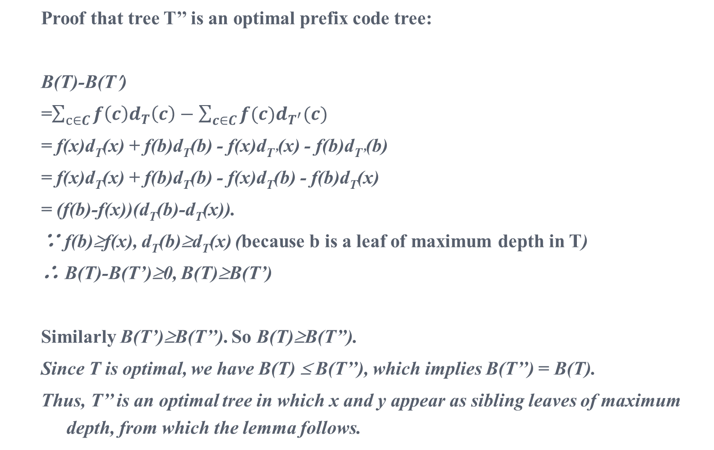
Proof of Lemma 2
Proof that tree T’’ is an optimal prefix code tree:
B(T)-B(T′)
=$\sum_{c∈C}{f\left(c\right)d_{T}\left(c\right)−\sum_{c∈C}{f(c)d_{T^{′}}(c)}}$
= f(x)d_{T}(x) + f(b)d_{T}(b) - f(x)d_{T’}(x) - f(b)d_{T’}(b)
= f(x)d_{T}(x) + f(b)d_{T}(b) - f(x)d_{T}(b) - f(b)d_{T}(x)
= (f(b)-f(x))(d_{T}(b)-d_{T}(x)).
∵ f(b)≥f(x), d_{T}(b)≥d_{T}(x) (because b is a leaf of maximum depth in T)
∴ B(T)-B(T’)≥0, B(T)≥B(T’)
Similarly B(T’)≥B(T’’). So B(T)≥B(T’’).
Since T is optimal, we have B(T) ≤ B(T’’), which implies B(T’’) = B(T).
Thus, T’’ is an optimal tree in which x and y appear as sibling leaves of maximum depth, from which the lemma follows.

Slide 56
Correctness of Huffman’s algorithm
Theorem 2
Procedure HUFFMAN produces an optimal prefix code.
Proof
Since Lemma 1 and Lemma 2 are valid, and Huffman algorithm performs local optimization selection according to the rules determined by greedy selectivity of Lemma 2, Huffman algorithm generates an optimized prefix coding tree

